Slide 1
Combining Behaviours
Basic steering behaviours
Higher level decision making
Pathfinding perhaps
Only gets us so far
Need to do more than just get to target
Avoid collisions with other NPCs
Avoid collisions with obstacles
e.g. Cone of vision
How do we join two behaviours together

Slide 2
Blending or Arbitration
Blending
Take a set of behaviours and their outputs
Execute all behaviours
Combine results using some weights/priorities
Is the final movement feasible?
Arbitration
Select one or more behaviours to have complete control over character
Change which behaviours get control based on circumstances
(we’ll also see Behaviour Trees later)
Combine blending with arbitration
Weights that change over time?
Weights = 0 mean ignore etc.

Slide 3
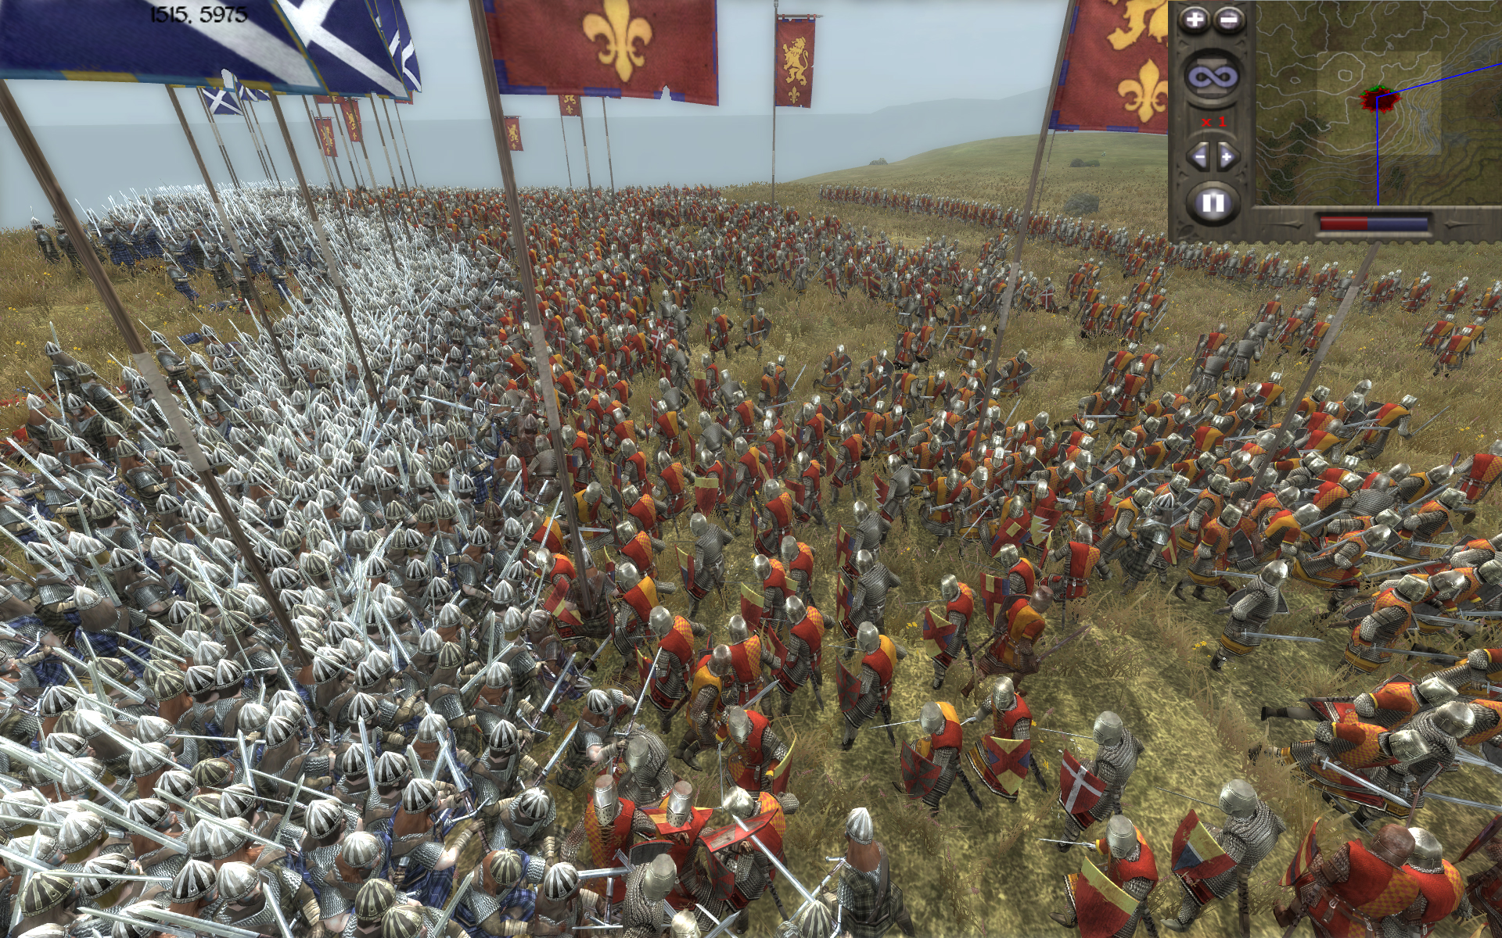
Blending or Arbitration
Crowd of rioting characters, want a mass movement where they stay by the others, while keeping a safe distance
blending: arriving at the centre of mass of the group and separation from nearby characters.
Weighted linear sum of acceleration
Weights do not need to sum to 1.
Watch for maxAcceleration.

Slide 4
Blending or Arbitration
May want to change weightings over time
Game situation
Character internal state
Have some process control weighting changes
Setting weights is not an exact science

Slide 5
Pseudo-Code
class BlendedSteering:
…
struct behaviourAndWeight:
behavior
weight
behaviours // list of behaviourAndWeight structs
def getSteering():
steering = new SteeringOutput()
foreach behaviour in behaviours:
steering.linear += behaviour.weight * behavior.behaviour.getLinAcc()
steering.angular += behavior.weight * behavior.behaviour.getAngAcc()
// ensure neither is above maxAcceleration!
…
return steering

Slide 6
Issues
More appropriate for large environments
Equilibrium
Behaviours cancel each other out
e.g. seek target, avoid enemy
usually unstable
due to numerical instability
but stable equilibrium can occur in the basin of attraction
Constrained Environments
pathological obstacle avoidance
can miss narrow doorways or passages
many developers design-in wide corridors
Nearsightedness
Decisions are made based only on local conditions (how does that compare with human intelligence?)
solution: incorporate pathfinding into behaviours
Important to get good debugging information

Slide 7
Priorities
A variation of behaviour blending.
Priorities instead of weights.
seek and evade always produce an acceleration
collision avoidance, separation, and arrive may suggest no acceleration. But when they do, they should not be ignored or diluted!
e.g. what happens when we blend seek() and collision()?

Slide 8
Priorities
Arrange behaviours in groups
Groups are prioritized
Behaviours are weighted in groups
Consider each group in turn
based on priority
If output of group is less than some minimum amount then move to next group
Continue until group output is above minimum
use this as output to behaviour
e.g. a pursuing character with 3 groups: collision avoidance, separation and pursuit
Conventionally called the epsilon parameter (ε)

Slide 9
Code
class PrioritySteering:
groups //Sets of behaviours and their
//blending weights in priority order
epsilon //A small epsilon parameter value
def getSteering():
for group in groups:
steering = group.getSteering()
if (steering.linear.length() > epsilon) or (abs(steering.angular) > epsilon):
return steering
return steering //otherwise just return the
//last group’s steering values

Slide 10
Equilibrium Fallback
Priority setting can help handle unstable and stable euilibria
Overall total acceleration will be close to zero
Add an additional behaviour at the lowest priority
Algorithm will drop down to lowest priority
e.g. wander

Slide 11
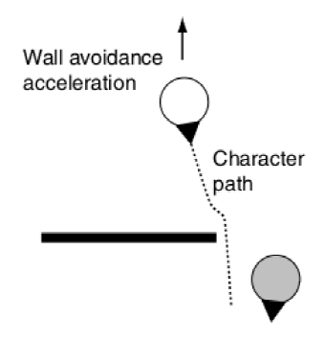
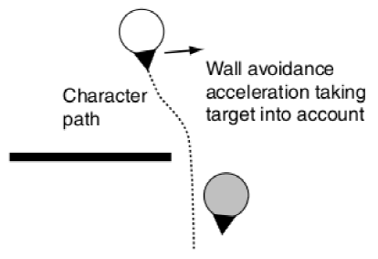
Cooperative Arbitration
Blending has stability problems
Priorities may lead to abrupt changes
Trend towards cooperation among different behaviours. That is, the response of one steering behaviour becomes context aware
adds complexity.
Cooperative Steering is handled with decision making techniques, such as, decision trees and state machines and others.

Slide 12
Specific Combinations
Specific combinations of behaviours in groups give us group behaviour e.g.
Flocking
Swarming

